Slide 1

OPSEC and Wireless Communications
DD MMM YY

Slide 2
Overview
OPSEC Overview
What is wireless
Use of wireless in the Navy
Why we can’t use wireless
Wireless threats
What we can do about it

Slide 3
References
National Security Presidential Memorandum (NSPM-28), 13 January 2021
National Operations Security Program
Department of Defense Instruction (DoDI) 8170.01, 2 January 2019, Online Information Management and Electronic Messaging
SECNAVINST 3070.2A, 9 May 2019, Operations Security
Notes:
Department of Defense Instruction (DoDI) 8170.01, 2 January 2019, Online Information Management and Electronic Messaging
Covers use of social media platforms, Applications and most on-line systems
SECNAVINST 3070.2A, 9 May 2019, Operations Security
NTTP 3-13.3M / MCTP 3-32B, September 2017, Operations Security
SECNAVINST 5720.44C W/CH-2, 21 February 2012, DON Public Affairs Policy and Regulations
Navy Social Media Handbook (2019)

Slide 4
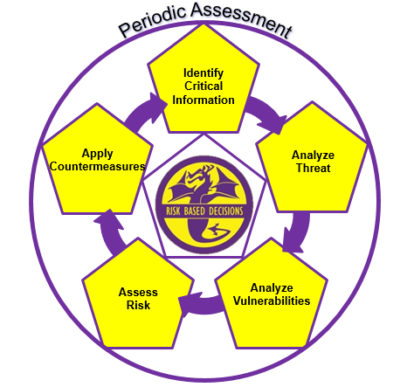
Operations Security (OPSEC)
The OPSEC cycle
  Identifies, controls and protects sensitive, critical unclassified information and indicators about a mission, operation or activity
  Assesses potential threats, vulnerabilities and risk
  Utilizes countermeasures to mitigate an adversary's collection capabilities against a friendly operation and periodically assesses friendly OPSEC effectiveness
Reduces the risk of our adversaries exploiting our vulnerabilities and obtaining our critical information
Notes:
Stress that the continuous OPSEC cycle is what OPSEC Officers use. They don’t really need to understand the 5 steps, the details of the cycle, but they need to understand what OPSEC is, in a general sense.
-Information can be unclassified, but still be “sensitive” and cause harm. We’ll explain.
-We will explain what exactly an adversary, or threat is in the next slide. We will also explain what a vulnerability is in a few minutes.

Slide 5
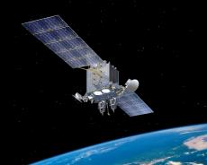

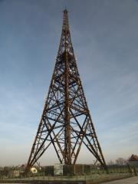
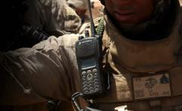
What is Wireless Communication?
Wireless communication is simply:
  The transfer of information between two devices that are not connected by an electrical conductor
  Generally, via a radio frequency signal upon which data is transmitted or received
Notes:
Wireless communication is simply:
The transfer of information between two devices that are not connected by an electrical conductor
Generally, via a radio frequency signal upon which data is transmitted or received

Slide 6
Can We Use Wireless Devices?
Yes. But according to DoDD 8100.02….
  Wireless devices shall not be used for storing, processing, or transmitting classified information without explicit written approval of the cognizant Designated Approving Authority (DAA)
  Cellular/PCS and/or other RF or Infrared (IR) wireless devices shall not be allowed into an area where classified information is discussed or processed without written approval from the DAA in consultation with the Cognizant Security Authority (CSA) Certified TEMPEST Technical Authority (CTTA)
  Wireless technologies/devices used for storing, processing, and/or transmitting information shall not be operated in areas where classified information is electronically stored, processed, or transmitted unless approved by the DAA
Essentially: You cannot operate a wireless device on a DoD network or in a classified area without prior consent of the DAA for the Navy
Notes:
Yes. But according to DoDD 8100.02…
Wireless devices shall not be used for storing, processing, or transmitting classified information without explicit written approval of the cognizant Designated Approving Authority (DAA)
Cellular/PCS and/or other RF or Infrared (IR) wireless devices shall not be allowed into an area where classified information is discussed or processed without written approval from the DAA in consultation with the Cognizant Security Authority (CSA) Certified TEMPEST Technical Authority (CTTA)
Wireless technologies/devices used for storing, processing, and/or transmitting information shall not be operated in areas where classified information is electronically stored, processed, or transmitted unless approved by the DAA
Essentially: You cannot operate a wireless device on a DoD network or in a classified area without prior consent of the DAA for the Navy

Slide 7

Why Can’t We Use Wireless Devices?
Wireless devices are inherently not secure

Slide 8
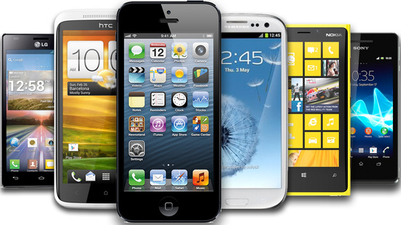
Smartphones
Smartphones are some of the most popular and intrusive wireless devices
Notes:
Smartphones are some of the most popular and intrusive wireless devices

Slide 9
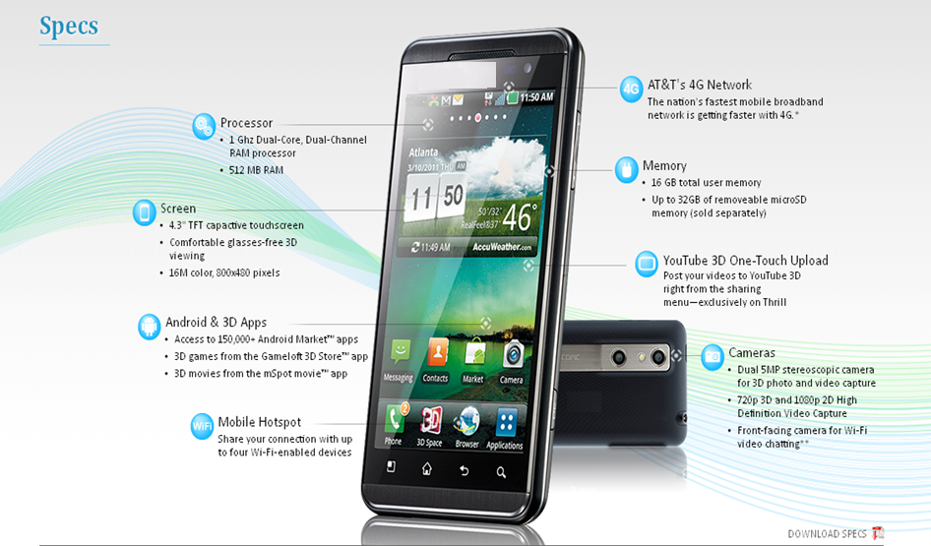
More Than Just a Phone
Notes:
Up until the mid 2000’s, the circled words on this screen were used to describe computers and their capabilities.
Do you associate any of these words with your home phone? That is if you still have one.

Slide 10

What Are We Really Doing?
Smartphones exist for many reasons…
  Primarily to transmit / receive information from one person to:
    Another person
    Many people
    Everyone
What information are we transmitting?
  Our conversations
  Our thoughts and ideas
  Pictures and videos
  Metadata
  Ambient data
  Unintentional data
  Personal data
Notes:
Smartphones exist for many reasons…
Primarily to transmit / receive information from one person to:
Another person
Many people
Everyone
What information are we transmitting?
Our conversations
Our thoughts and ideas
Pictures and videos
Metadata
Ambient data
Unintentional data
Personal data

Slide 11
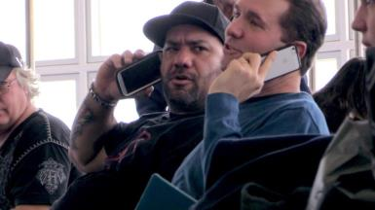

Talking
Conversation in public
  Does everyone around you need to know what you are talking about
  Does your side of the conversation give away critical information
Be aware of your surroundings
  Be conscious of the information you are
  speaking about
  Who else may be listening
Don’t sell the farm
Notes:
So when we do talk on our smartphones, do we do it as if nobody is around to hear us? What are you talking about when you are on the phone?
Conversation in public
Does everyone around you need to know what you are talking about
Does your side of the conversation give away critical information
Be aware of your surroundings
Be conscious of the information you are
speaking about
Who else may be listening
Don’t sell the farm

Slide 12
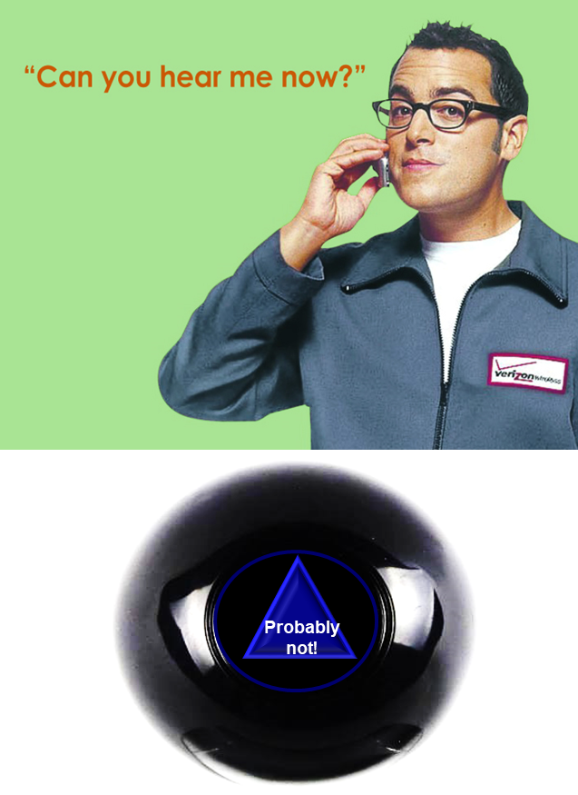
Who’s Talking
90% Mobile phone time is spent on apps.
98% of Generation Z own a smartphone.
  Around 52% say that their mobile phones are their most valuable assets.
92% of Generation X own a cell phone
  Still value their desktop computers more.
Source: Leftronic.com
In your opinion, is one generation more at risk over the other? If so, what makes you feel one is more vulnerable?
Does anyone talk on the PHONE anymore?
Notes:
90% Mobile phone time is spent on apps.
98% of Generation Z own a smartphone.
Around 52% say that their mobile phones are their most valuable assets.
92% of Generation X own a cell phone
Still value their desktop computers more.
Source: Leftronic.com
In your opinion, is one generation more at risk over the other? If so, what makes you feel one is more vulnerable?
Does anyone talk on the PHONE anymore?

Slide 13






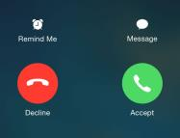
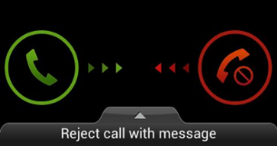
Other Smartphone Capabilities
GPS and EXIF data
Microphone
Bluetooth
Video Recording
Accelerometer
Web browsing
Near Field
Communication
Radio Frequency
Identification
Notes:
Smartphones have many capabilities, to name a few:
Describe each capability
GPS and EXIF data
Microphone
Bluetooth
Video Recording
Accelerometer
Web browsing
Near Field
Communication
Radio Frequency
Identification

Slide 14
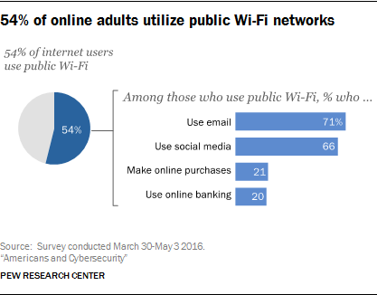
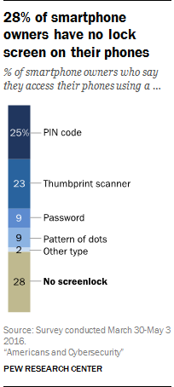
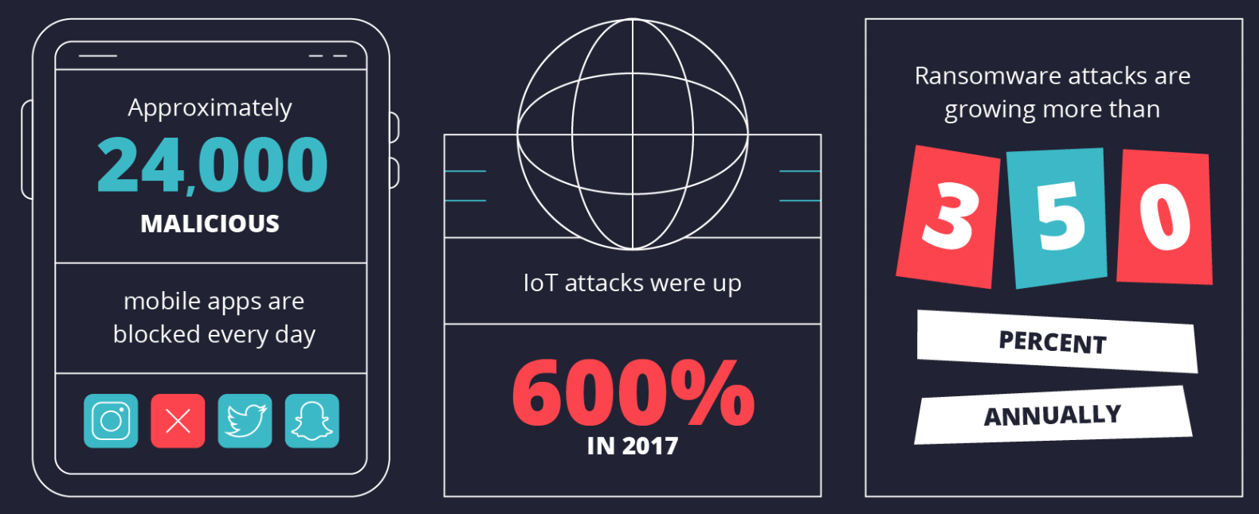
Mobile Stats

Slide 15
US Leading Mobile phone Activities - June 2018
Less than once a day
1-3 times per day
4-7 times per day
8-10 times per day
More than 10 times per day
Don’t Know / No Opinion
Update social media | 43% | 27% | 10% | 5% | 6% | 12%
Make phone calls | 24% | 44% | 17% | 7% | 6% | 12%
Respond to text messages | 16% | 30% | 19% | 13% | 18% | 11%
Take photos or record videos | 51% | 27% | 8% | 3% | 4% | 9%
Listen to music, audiobooks or podcasts | 48% | 23% | 8% | 4% | 5% | 7%
Watch television, movies or other video content | 49% | 22% | 9% | 3% | 5% | 4%
Use GPS navigation or call a ride through a ridehailing app | 63% | 18% | 3% | 1% | 2% | 4%
Source: Statista.com
2,200 people polled
Ages 18 and up

Slide 16
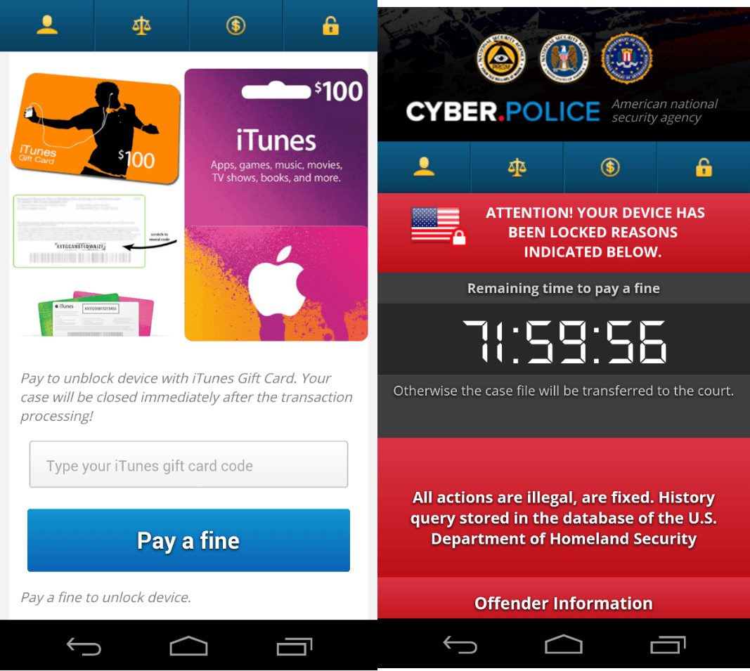
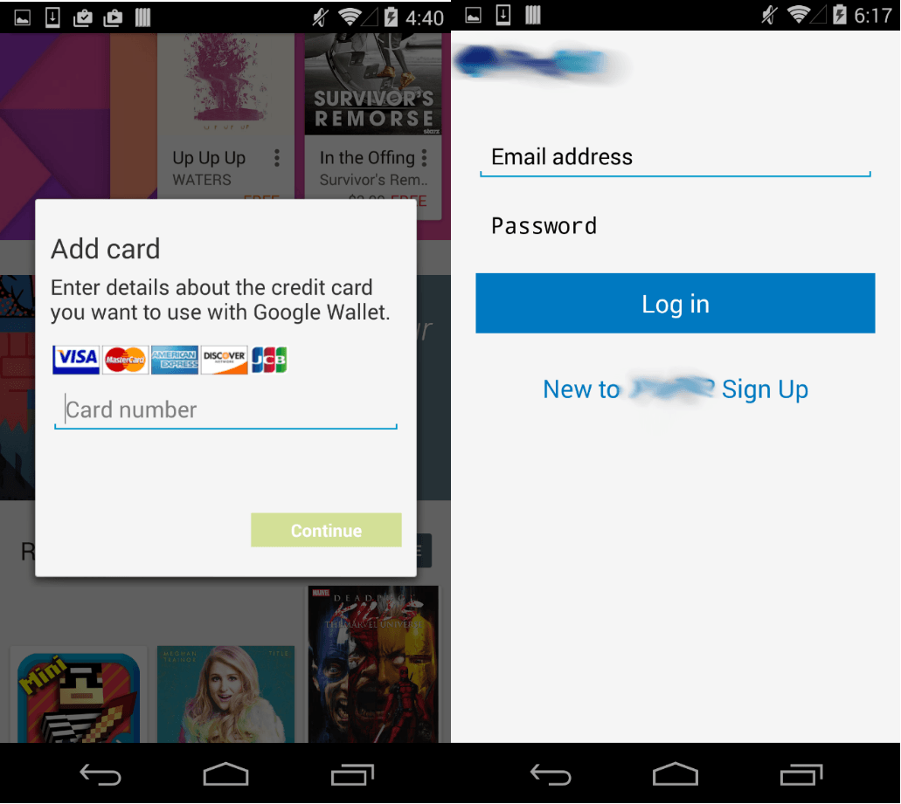
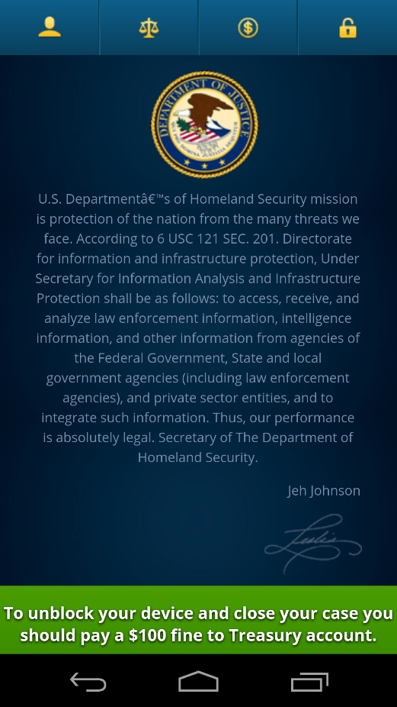
FBI Insight
"Mobile phones are a huge source of vulnerability. We are definitely seeing an increase in criminal activity.”
  Gordon Snow, assistant director of the Federal Bureau of Investigation's Cyber Division
Notes:
Contact lists, location data, text messages, Social Networking and banking information are just some of the things stored on or conducted with smartphones. Is this information important to you? How cautious are you with your information?

Slide 17
An App for That
2.1 million Apps available through Google Play
1.8 million Apps available through Apple App store
Notes:
There is an App for everything today. Ask yourself if you need the App…..and if not, remove/delete.
Think about all of the ToS for each App
What data have you authorized the vendor to access

Slide 18
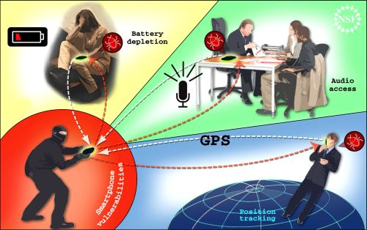
Vulnerabilities
Before you surrender your life to your smartphone, ensure you research and understand the vulnerabilities that may come with the technology
Notes:
Smartphones are great tools for our everyday life, but they also open our lives up to adversaries hoping to do us harm in some sort of fashion.

Slide 19
WiFi
WiFi networks beacon their SSID so wireless devices can locate the network and the network access point
With free and simple to use software, someone could easily hack a WiFi network password that uses WEP, or WPA encryption
  If you are not using WPA2 to secure your WiFi network you are vulnerable to attack
Wardriving: Driving around to find weakly secured WiFi networks to hack
If you are on the same network as someone else, you are trusting them to have access to ALL of your files
Notes:
WiFi networks beacon their SSID so wireless devices can locate the network and the network access point
With free and simple to use software, someone could easily hack a WiFi network password that uses WEP, or WPA encryption
If you are not using WPA2 to secure your WiFi network you are vulnerable to attack
Wardriving: Driving around to find weakly secured WiFi networks to hack
If you are on the same network as someone else, you are trusting them to have access to ALL of your files

Slide 20
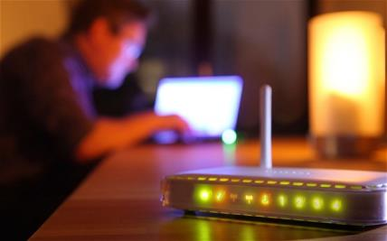
WiFi Cont’d
Computers that have Wireless Network Interface Cards are also susceptible to attack:
  Attackers can search for and locate Wireless NICs on devices and then remotely connect to those devices
  This can be done by spoofing the MAC address of a trusted device or simply beaconing the NIC
Notes:
Computers that have Wireless Network Interface Cards are also susceptible to attack:
Attackers can search for and locate Wireless NICs on devices and then remotely connect to those devices
This can be done by spoofing the MAC address of a trusted device or simply beaconing the NIC

Slide 21
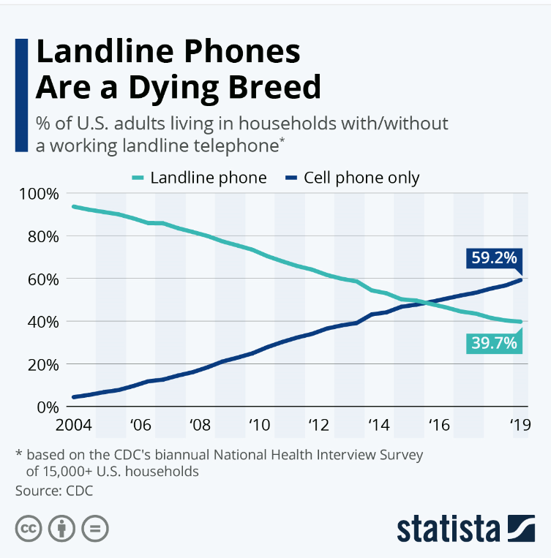
Landline vs. Wireless
Notes:
The take-away for this slide is that landlines are much more secure than a wireless devise and more people are willing to sacrifice security for convenience. Can an adversary steal your personal information from your home phone? Answer: No. your home phone does not have texting capability, does not have file sharing capability, does not have banking account information, does not have geo tracking history and the list can go on and on. Not to mention that tapping a landline phone is far more difficult and risky just to get conversations.

Slide 22
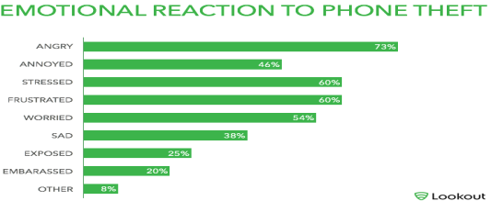
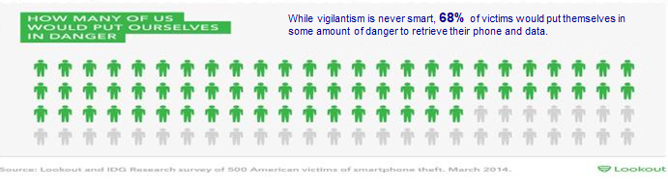
Value
How would you feel if your phone was lost or stolen
What would you do to get it back
Notes:
The information on this slide shows we truly do feel we have important information on our phones, but many people ONLY think of the devise being physically accessed if lost or stolen. There are adversaries out there that have the capability to access your phone without physical access.

Slide 23
Tradeoff
What would you be willing to trade for the use of your cellphone?

Slide 24

Security Risk
What is the biggest security risk when it comes to wireless usage?
Answer: You……. The user.
Like most people, when it comes to new technology, we want it and we want it now. We usually start using this technology for all the benefits promised without understanding the vulnerabilities or the security features available

Slide 25
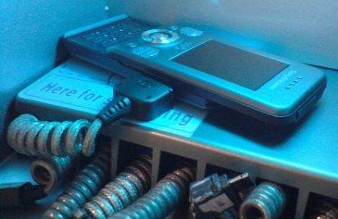
Navy Networks
PPEDs are prohibited:
  If they contain cellular and/or Wi-Fi transceivers, or other technologies not permitted in para 5.a. of this ALNAV.
  If they have photographic, video capture/recording, microphone, and/or audio recording capabilities.
  From being connected to any government information system either directly or indirectly using wired or wireless accessories (e.g., Bluetooth dongles and charging cables).
  If they have removable media installed.
  If they have the capability to perform radio frequency transmissions at greater than 100 milliwatts (mW) Equivalent Isotropically Radiated Power (EIRP). Where feasible, EIRP shall be determined using FCC data.
DON’T DO IT
Notes:
Can introduce malicious code to the network, provide an exfiltration data point from the device, or provide adversaries access to critical unclassified or classified networks
This includes connecting a smartphone to a DON computer “just to charge it”. Lack of compliance could result in data exfiltration, spillage and the spread of malware

Slide 26
Recommendations
Never store sensitive data on smart phones
Enable password protection
Update device regularly, include anti-virus software
Do not open suspicious email or click unknown links
Do not leave phone unattended in public
Activate lock-out screen
Enable encryption where possible
Only purchase apps from legitimate marketplaces
Turn off GPS & Bluetooth when not in use
Never “jailbreak” or “root” smartphone
Understand apps you download/use and what data the app accesses
Disable Geo-tagging
Keep phone screen clean
Data sanitize your device before redistributing
Notes:
Recommendations for smartphone use.
Never store sensitive data on smart phones
Enable password protection
Update device regularly, include anti-virus software
Do not open suspicious email or click unknown links
Do not leave phone unattended in public
Activate lock-out screen
Enable encryption where possible
Only purchase apps from legitimate marketplaces
Turn off GPS & Bluetooth when not in use
Never “jailbreak” or “root” smartphone
Understand apps you download/use and what data the app accesses
Disable Geo-tagging
Keep phone screen clean
Data sanitize your device before redistributing

Slide 27
Don’t Be the One
…that introduces a vulnerability into our DoD networks
  Our adversaries are constantly probing our network for weaknesses in order to:
    Collect critical or classified information
    Interrupt our ability to communicate
    Attack our critical infrastructure
    Decrease our capabilities
    Decrease our mission effectiveness
If you do not understand the risk you cannot assume it
Be a good steward of technology and information
Notes:
Who introduces a vulnerability into our DoD networks
Our adversaries are constantly probing our network for weaknesses in order to:
Collect critical or classified information
Interrupt our ability to communicate
Attack our critical infrastructure
Decrease our capabilities
Decrease our mission effectiveness
If you do not understand the risk you cannot assume it
Be a good steward of technology and information

Slide 28
Summary
OPSEC Overview
What is wireless
Use of wireless in the Navy
Why we can’t use wireless
Wireless threats
What we can do about it

Slide 29

Contact Information
Your Logo here
Your Command OPSEC Program Manager information here.
OPSEC@Navy.mil or NAVY_OPSEC@us.navy.mil
757-203-3656
NAVAL INFORMATION FORCES
ATTN: NAVAL OPSEC SUPPORT TEAM
115 LAKE VIEW PARKWAY
SUFFOLK, VIRGINIA 23435

